Slide 1
Dr Navneet Arora,
Senior Resident,
Department of Internal Medicine,
PGIMER, Chandigarh.

Slide 2
Introduction
Majority of SARS-CoV-2 asymptomatic
Substantial proportion if infected individuals develop a respiratory illness requiring hospital admission and ventilatory support
Case fatality rate over 37% in patients requiring ventilatory support
Hypoxic respiratory failure is associated with systemic inflamation, relese of proinflamatory cytokines IL-1, IL-6, and TNF α

Slide 3
Introduction
Toclizumab is a recombinant humanised anti-IL-6 receptor monoclonal anitbody
Inhibits binding of IL-6 to both membrane and soluble IL-6 receptors
Blocks IL-6 signaling and reduces inflammation
Trial aimed to evaluate the effects of toclizumab in adult patients admitted to the hospital with COVID-19 with both hypoxia and systemic inflamation

Slide 4
Methods
Investigator-initiated, individually randomized, controlled, open-label, platform trial
Evaluates the effect of potential treatments in patients hospitalized with COVID-19
Done in acute National Health Service hospital in the United Kingdom
Findings are limited to adult population

Slide 5
Methods
Hospitalized patients, with clinically suspected or laboratory confirmed patients with SARS-CoV-2 infection were eligible
Data collected via web-based case report form
Eligible and consenting patients received usual standard of care and underwent an initial (main) randomization, up to 3 parts
No additional treatment versus either dexamethasone, lopinavir-ritonavir, hydroxychloroquine, azithromycin, or colchicine
No additional treatment versus convulsant plasma or REGN-COV2
No additional treatment versus aspirin

Slide 6
Methods
RECOVERY trial participants with progress COVID-19 were considered for randomization to toclizumab versus usual care alone up to 21 days after main randomization.
Progressive COVID-19 was defines as oxygen saturation of <92% on room air or receiving oxygen therapy, and CRP ≥75 mg/L.
Participants and local study staff were not masked to the allocated treatment.

Slide 7
Methods
Dose of toclizumab was established by body weight
>90 Kg: 800 mg
>65 to ≤ 90 Kg: 600 mg
>40 to ≤ 65 Kg: 400 mg
≤40 Kg: 8mg/Kg
A single online follow-up form was completed at discharge, 28 days after randomization, or death, whichever occurred earliest.
Outcomes assessed at 28 days, with future analysis specified at 6 months

Slide 8
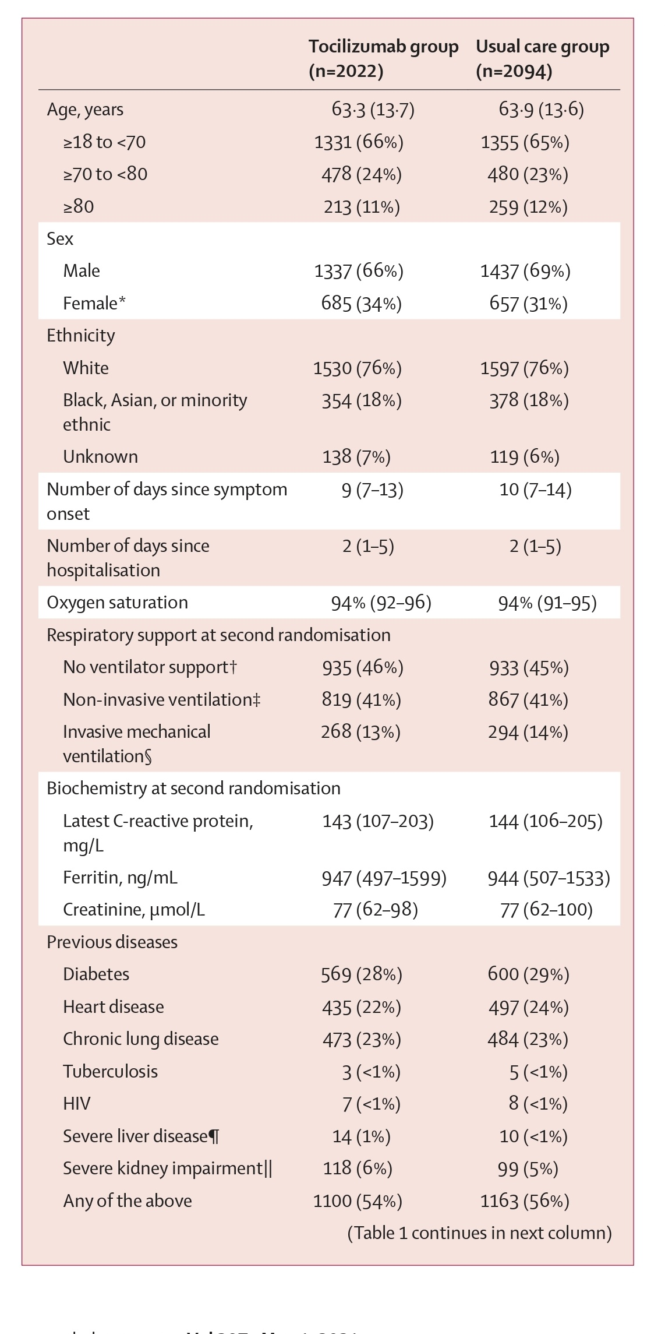
Methods

Slide 9
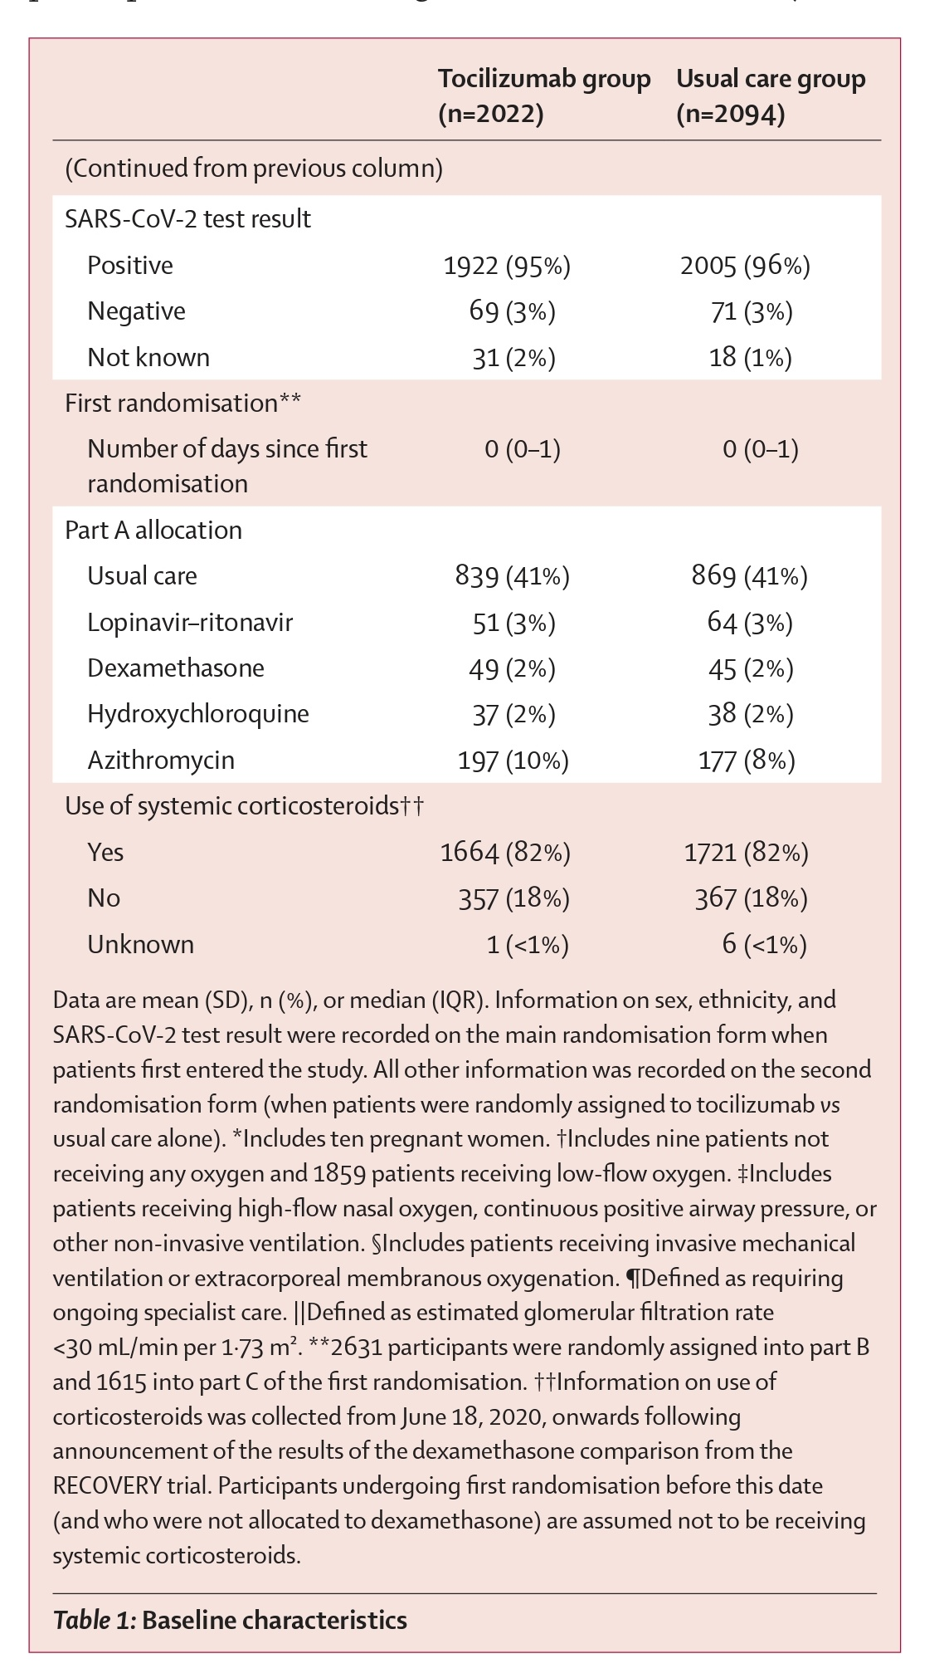
Methods

Slide 10
Outcomes
Primary outcomes
All cause of mortality
Secondary outcomes
Time to discharge from the hospital
Receipt of invasive mechanical ventilation or death

Slide 11
Outcomes
Prespecified subsidiary clinical outcomes
Use of non- invasive respiratory support
Time to cessation of invasive mechanical ventilation
Use of renal dialysis, or haemofiltration
Prespecified safety outcome
Cause specific mortality
Major cardiac arrhythmia

Slide 12
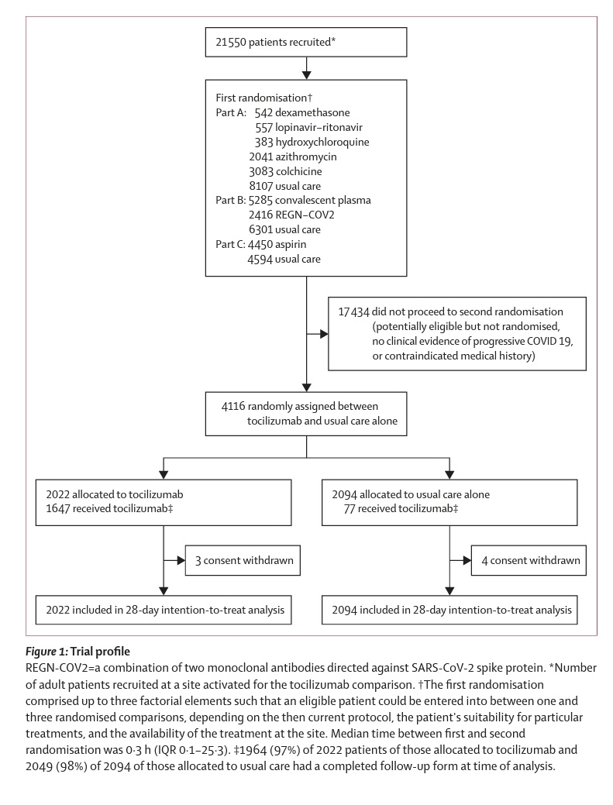
Statistical Analysis

Slide 13
Results
Toclizumab group was associated with a mortality of 31% versus 35% in usual care group
Greater probability of discharge from hospital within 28 days in toclizumab group 57% versus 50% in usual care group
Reduction in risk of progression to mechanical ventilation or death in toclizumab group versus usual care group (35% versus 42%)

Slide 14
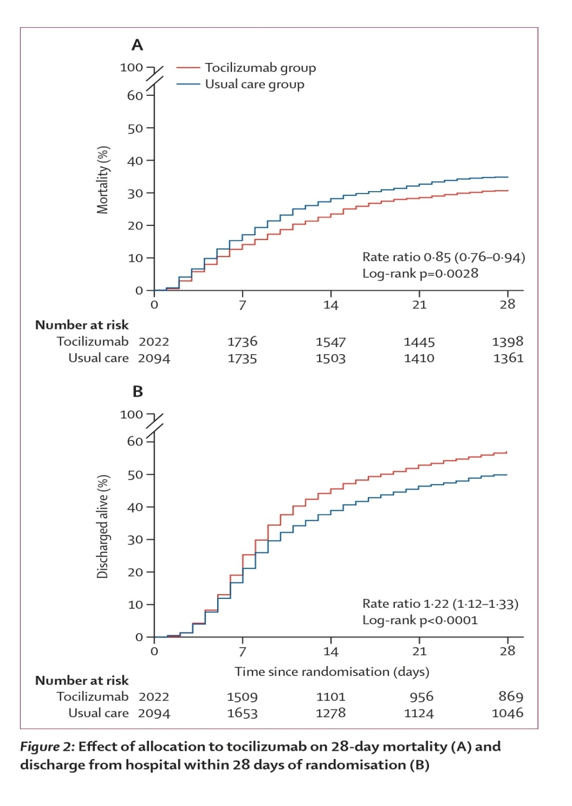
Results

Slide 15
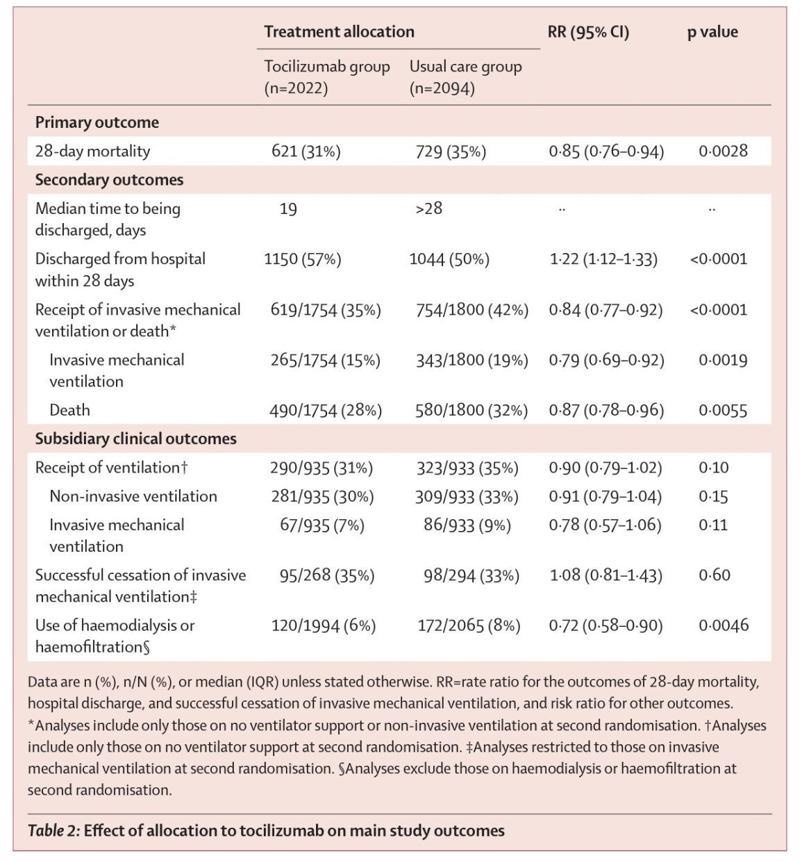
Results

Slide 16
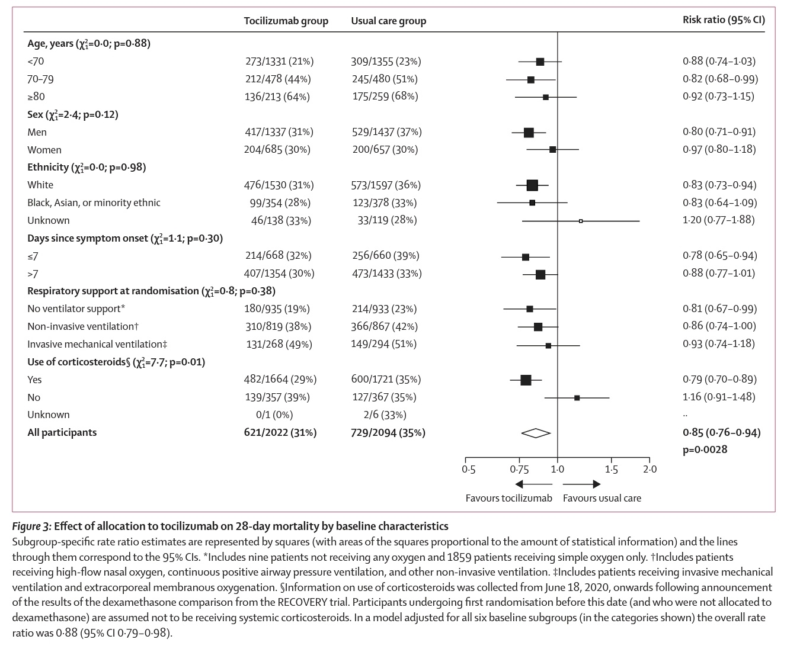
Results

Slide 17
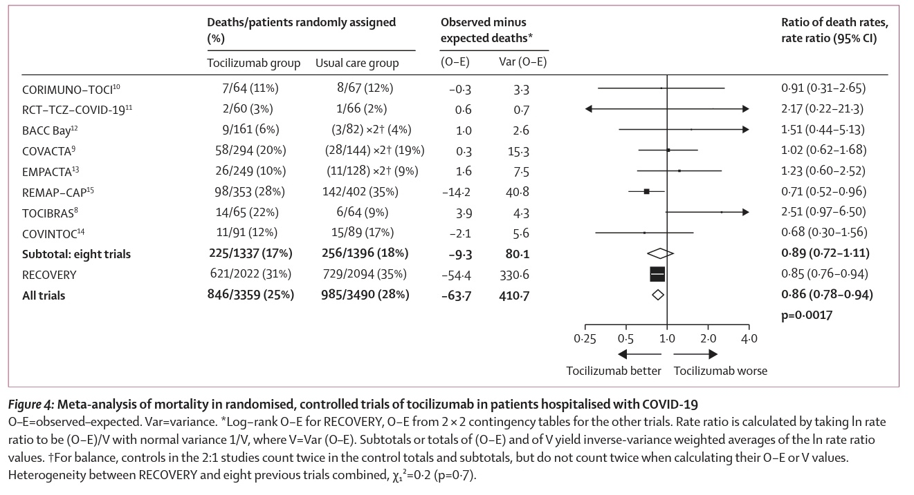
Results

Slide 18
Results
Three reported adverse events related to toclizumab noted
Otitis Externa
Staphylococcus aureus bacteriemia
Lung abscess
All of the adverse events can be tackled with standard treatment

Slide 19
Discussion
Toclizumab, effective treatment, for COVID-19 patients having hypoxia and evidence of inflammation (CRP ≥75 mg/L).
Improves survival and chances of discharge from the hospital by 28 days
Reduces chances of progression to invasive mechanical ventilation
Benefits consistent across all patient groups including those receiving invasive mechanical ventilation, non-invasive respiratory support, or no respiratory support at all
Benefits also seen in patients receiving corticosteroids along with oxygen supplementation

Slide 20
Discussion
8 randomized, controlled trials of toclizumab for treatment of COVID-19 have been reported since mid-2020, showing no significant mortality benefit.
RECOVERY trial, alone, contains four time more information as previous trials
All 9 trials, when assessed together, are associated with 14% proportional reduction in 28 days mortality
Patients who are hypoxic, and have systemic inflammation, toclizumab reduces mortality in 33% patients with oxygen support, and about 50% patients receiving mechanical ventilation

Slide 21
Strengths
Randomized
Large sample size
Patients enrolled required various amount of respiratory support
99% completeness of follow-up
CRP chosen as a marker which is cheap and easily available

Slide 22
Limitations
16% patients included in the trial did not receive toclizumab for some reason
Long hospital stay for many patients, outcome is not reflected in 28-days follow-up
No information on non-COVID-19 infections

Slide 23
Take Home Message
RECOVERY trial has shown that for hospitalized patients with severe COVID-19, treatment with toclizumab reduces mortality, increases the chances of successful hospital discharge, and reduces chances of invasive mechanical ventilation.
These benefits are additional to those reported for dexamethasone
Toclizumab, thus can be used as standard care in sever COVID-19 infection, along with oxygen support and dexamethasone.

